Slide 1
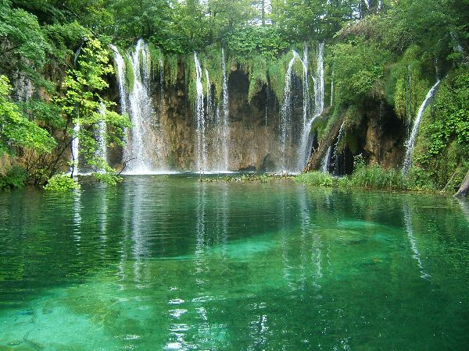
Globally, >1 000 000 spp rely on tropical freshwater ecosystems for survival.
References:
- Fresh water biome facts and information, bioexpedition.com, BioExpedtion

Slide 2
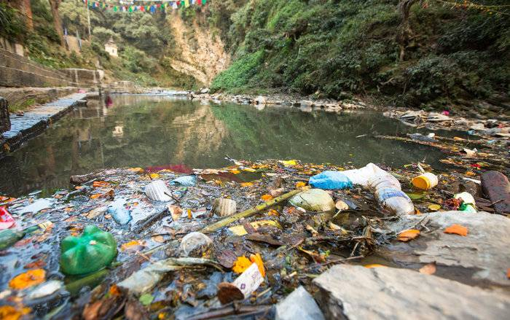
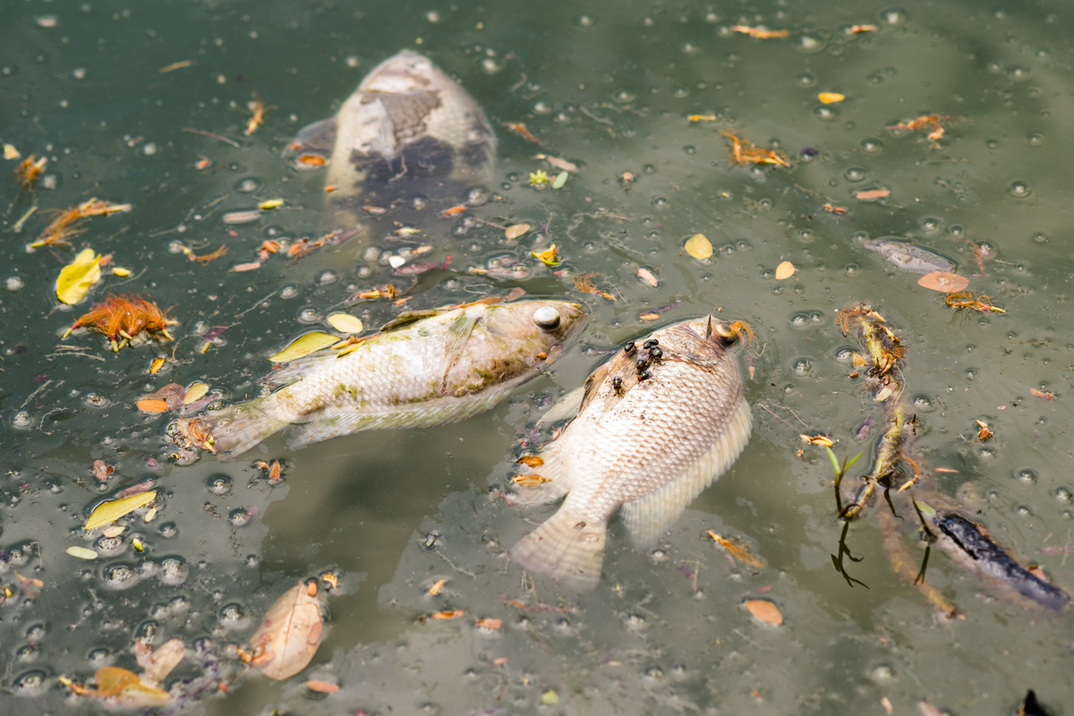
Threat to Aquatic Systems
1. Large scale degradation of aquatic systems:
    Pollution, global warming,
    Deforestation.
      2. Deteriorating water quality impact biology.
      In some areas, a third to a half of fish and amphibian spp extinct or endangered.
References
- Top right :Groundwater Contamination,lawyertime.com,LawyerTime
- Bottom right: Tragic effects of water pollution on animals, helpsavenature.com, HelpSaveNature
-

Slide 3
Questions
1. How Does this degradation effect fresh water crabs
2. Why is it important to know
  - What are freshwater crabs?
  - Where are they found?
  - what ecological roles do they fill?
  - What economic impact do they have?

Slide 4
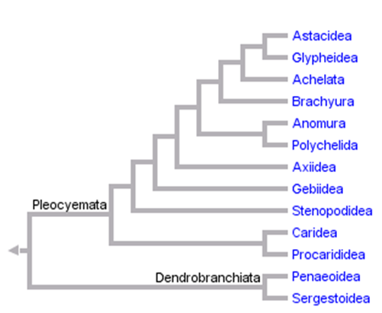
What are Freshwater crabs?
1. Crabs of decapods of the infraorder Branchyra ( largest of all decapod groups).
2. One fifth of all crabs are freshwater crabs, including the superfamilies:
  - Gecarinucodiea, Potamoidea,
  Psuedothelphusodiea, and
  Trichodactyloidea.
References
-Alistair Lavers, 2013, Taxonomy of the Decapods, gbri.org.au, University of Queensland

Slide 5
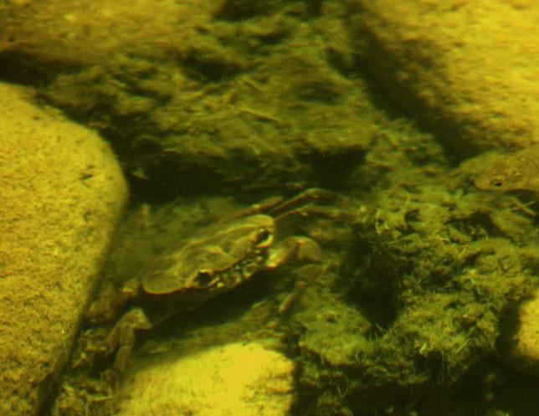
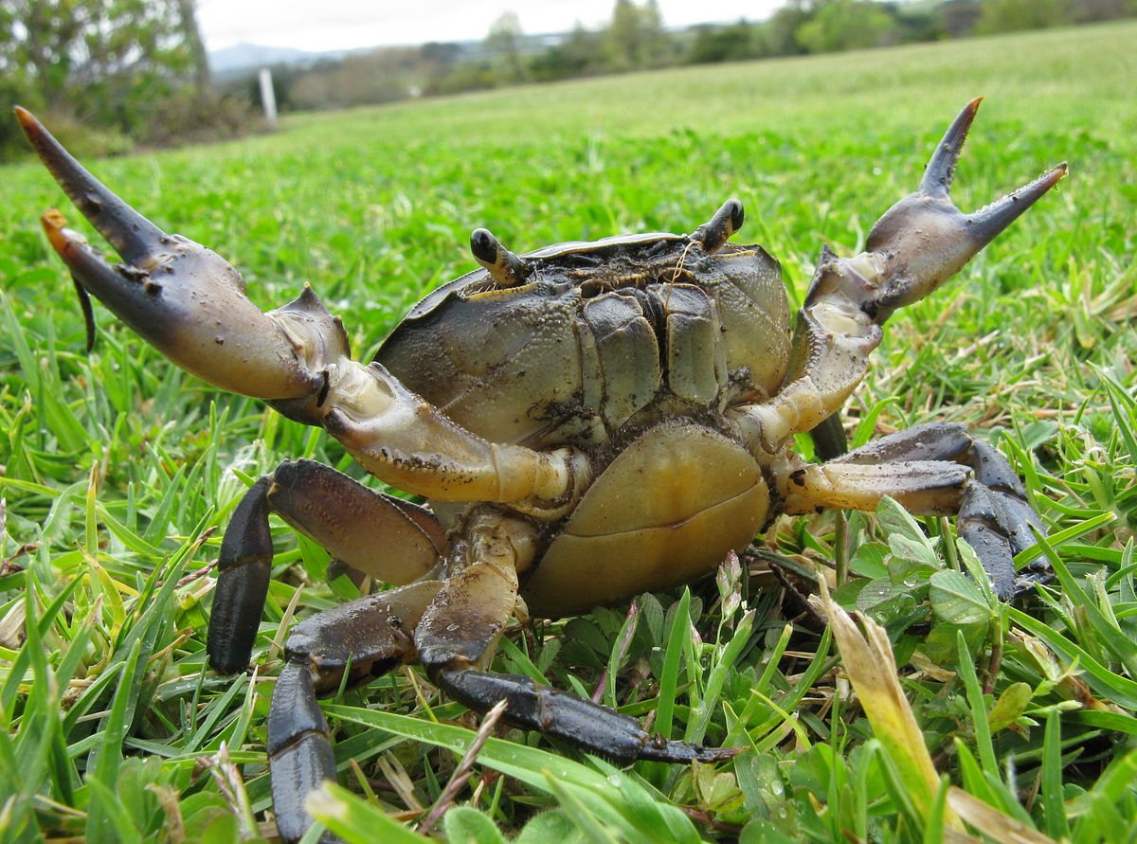
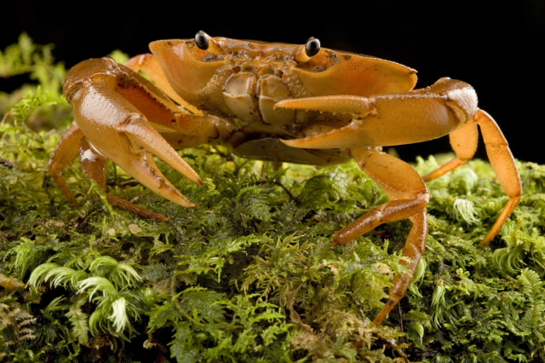
Where are they found?
1. Almost all clean water bodies from moist lowland forests to rugged mountains
- Rivers, Streams waterfalls, karsts, and caves.
2. Many are also semi-terrestrial.
3. Require pristine water conditions to survive
References
-Left: 2012,Fresh water crab in a stream at Bharal Morni,hillsofmorni.com,Hills of Morni
- Center: John Richfield,2011 Potamonautes perlatus Cape River Crab,wikipedia.org, Wikimedia project
- Right: 2010, Freshwater Crab, blog.conservation.org, Conservation International

Slide 6
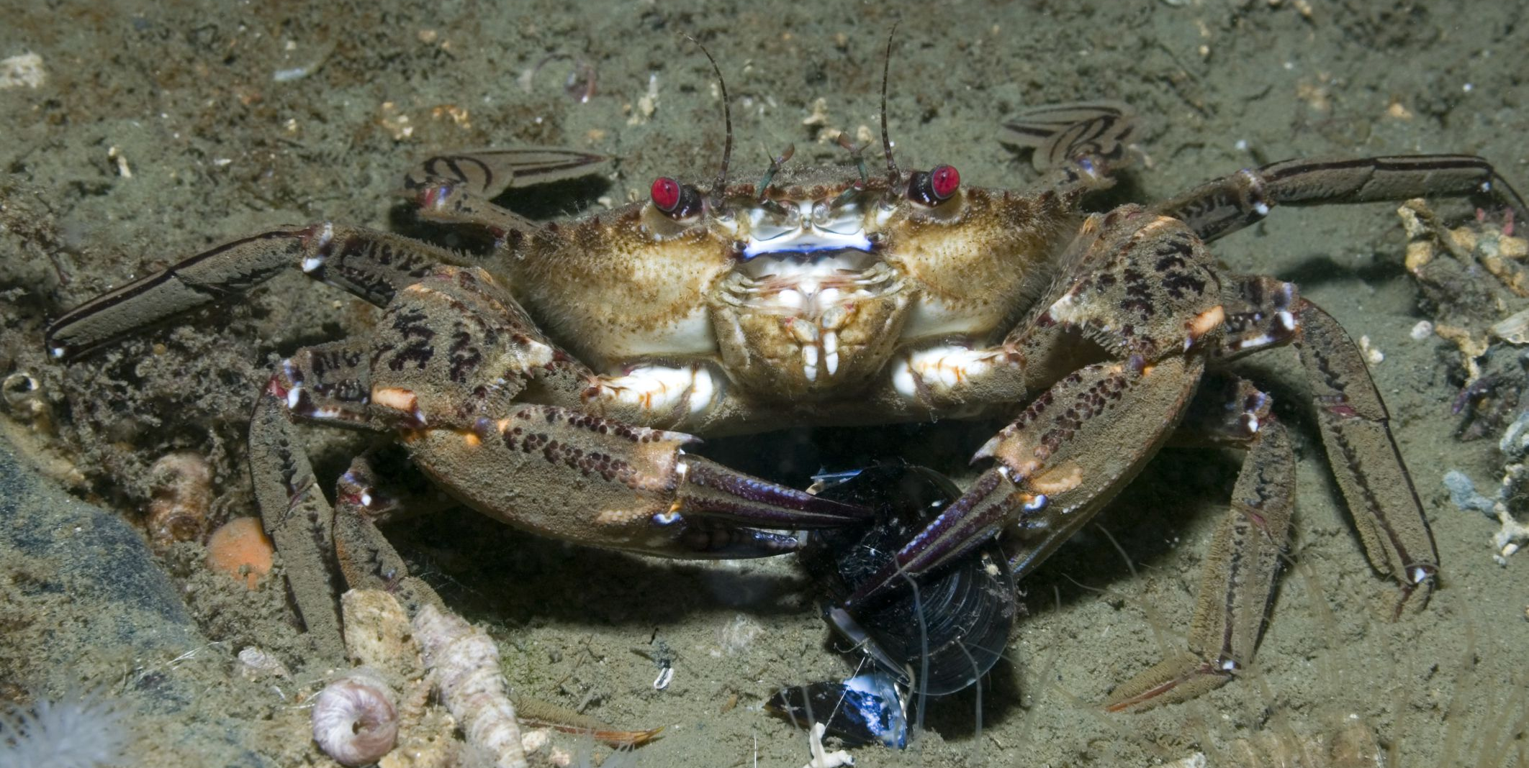
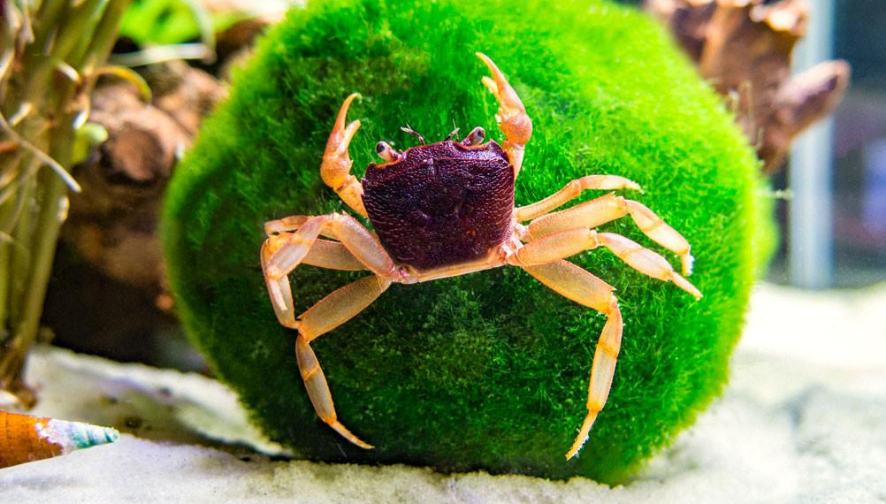
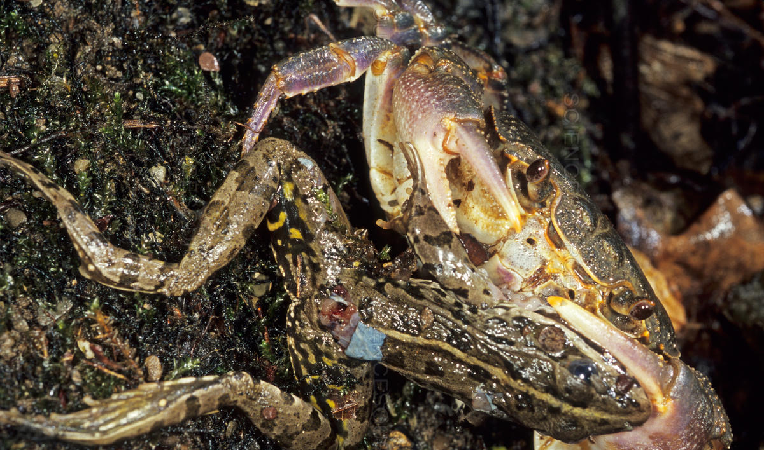
Ecological Role
1. Carnivores (Predators)
    Control populations of aquatic insects
    and gastropods.
2. Herbivores
    Fallen leaves, algae and beechnuts.
3. Detritivores
    Dead frogs and snakes.
References
- Top: Velvet Crab eating paulkay getty, fthmb.tqn.com, ThoughtCo
- Middle: matano crab, shopify.com, Aquatic Arts
- Bottom: Crab(Potamon fluviatile) eating frog, science source.com, Science Source

Slide 7
Nutrient Cycling
1. Crabs are very important to the dynamics of nutrient cycling
a) Detritivor feeding habits
-Shredding guild
b) Dominant Ecosystem player.
- 88-94% of overall biomass in the streams and debris dams in the
eastern Usambara Mountains of Tanzania.

Slide 8
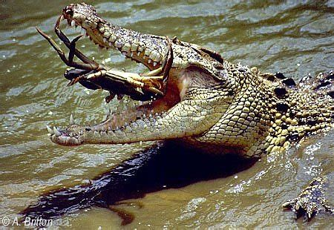
Prey species
1. Freshwater crabs serve as a food source for a wide range of predators.
    Otters, mongooses, civets, kites, egrets, herons, and kingfishers, eels bullfrogs, toads, monitor lizards and crocodiles, turtles, capuchin monkeys, wild boar, and stream snakes.
References
- James Ryan, 2011, Crocodile eating Crab, animalseatinganimals.com, Nature at Work

Slide 9
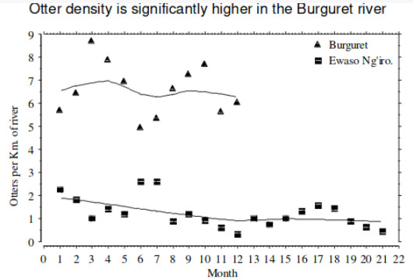
Prey species
1. Invasive North American crayfish, replaced native crabs in western Kenya
2. Upward trophic cascade, decrease in clawless otter populations.
References
- 2004, Mordecai O. Ogada, University of Nairobi

Slide 10
Genetic diversity
1. Allopatric speciation
    - Low fercundity
    - Low vagility
    - Fragmented aquatic water bodies
2. Sympatric speciation
    - Niche specialisation
    - Up to 5 different species in one site

Slide 11
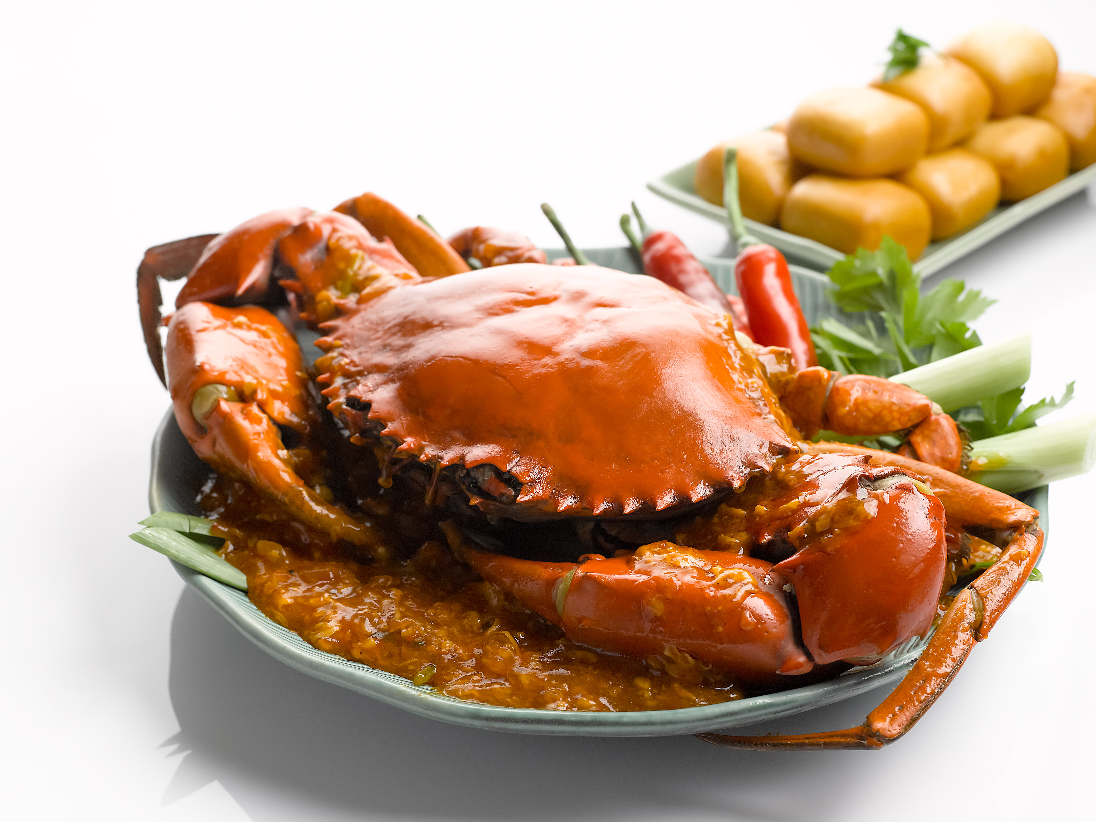
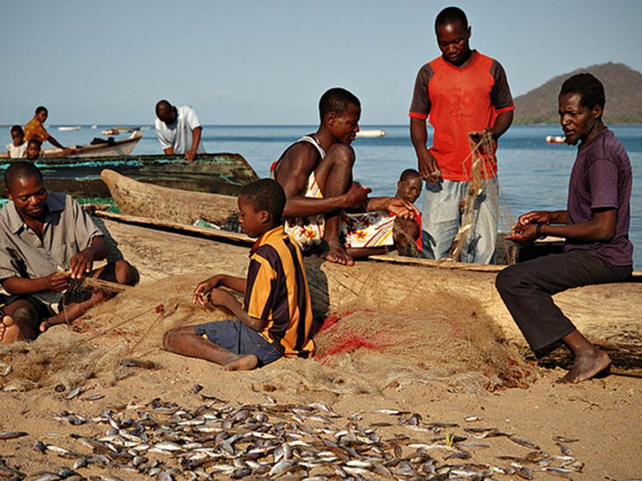
Economic importance
Crabs as a food Source
1. The direct consumption of Crabs as a food source is wide spread
2. Crab fisheries in Lakes Malawi and Tanganyika fuel local economies.
References
- Left: Coffee Cake Crab, eastiebrekkie.com, Eastie Brekkie
- Right: Fishmarako,responseabilityalliance.com, Responsability Alliance

Slide 12
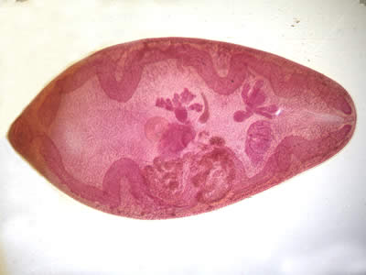
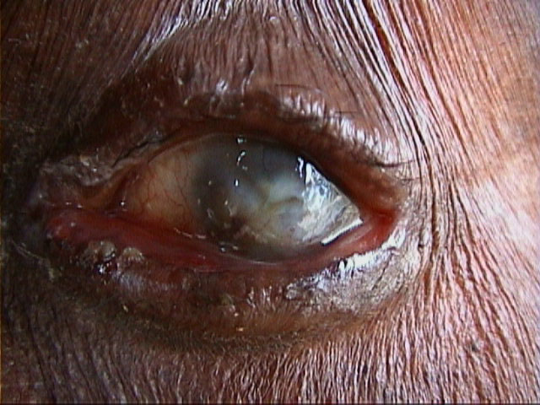
Medical importance
1. Crabs act as a host species for several important human parasites
a) Paragonimiasis:
  - food borne zoonosis
  - diarrhea, abdominal pain, fever, cough, pulmonary
  - abnormalities
  - 20 million people infected world wide.
b) Biting blackfly. Simulium spp,
- Vector of infection for parasite Onchocerca volvultus,
which causes onchocerciassis (river blindness).
References
- Top: 2007,Paragonimus adult hematoxylin,www.cdc.gov,Centers for disease control and prevention
- Bottom: 2004, Onchocerciasis,web.standford.edu, Standford University

Slide 13
Anthropic effects
1. Lack of research detailing current ecological status
2. Existing research suggests many freshwater crab species seriously endangered
3. 2008 IUCN Red list increased number of threatened of endanger species from 93 to 1280 globally.

Slide 14
Reseach Goals
1. Assess anthropic effects and ecological status of fresh water crabs.
2. Comprehensive study including
    - 1280 freshwater crabs
    - Tropical regions of Americas, Africa, Asia and Australasia.
    - All five major families (as above)

